Slide 1
Programming Practice Questions

Slide 2
Basic Programming Exercise

Slide 3
Task 1
Write a program to enter two number and find their sum.

Slide 4
Task 2
Write a program to enter two numbers and perform all arithmetic operations

Slide 5
Task 3
Write a program to enter length and breadth of a rectangle and find its perimeter.

Slide 6
Task 4
Write a program to enter length and breadth of a rectangle and find its area.

Slide 7
Task 5
Write a program to enter radius of a circle and find its diameter, circumference and area.

Slide 8
Task 6
Write a program to enter length in centimeter and convert it into meter and kilometer.

Slide 9

Task 7
Write a program to enter temperature in Celsius and convert it into Fahrenheit.

Slide 10

Task 8
Write a program to enter temperature in Fahrenheit and convert to Celsius.

Slide 11
Task 9
Write a program to convert days into years, weeks and days.

Slide 12
Task 10
Write a program to find power of any number x^y

Slide 13
Task 11
Write a program to enter any number and calculate its square root.

Slide 14
Task 12
Write a program to enter two angles of a triangle and find the third angle.

Slide 15
Task 13
Write a program to enter base and height of a triangle and find its area.

Slide 16
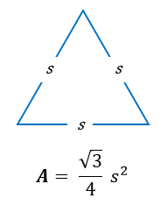
Task 14
Write a program to calculate area of an equilateral triangle.

Slide 17
Task 15
Write a program to enter marks of five subjects and calculate total, average and percentage.

Slide 18
Task 16
Write a program to enter P, T, R and calculate simple interest.

Slide 19
Task 17
Write a program to enter P, T, R and calculate Compound Interest.

Slide 20
Conditional Operators Programming Exercise

Slide 21
Task 1
Wrote a program to find maximum between two number using conditional operator

Slide 22
Task 2
Write a program to find maximum between three numbers using conditional operator

Slide 23
Task 3
Write a program to check whether a number is even or odd using conditional operator

Slide 24
Task 4
Write a program to check whether year is leap year or not using conditional operator

Slide 25
Task 5
Write a program to check whether character is an alphabet or not using conditional operator

Slide 26
If……else statement

Slide 27
Task 1
Write a Java Program to find maximum between two number by using selection statement

Slide 28
Task 2
Write a program to find maximum between three numbers

Slide 29
Task 3
Write a program to check whether a number is negative, positive or zero.

Slide 30
Task 4
Write a program to check whether a number is divisible by 5 and 11 or not.

Slide 31
Task 5
Write a program to check whether a year is leap year or not.

Slide 32
Task 6
Write a program to check whether a number is even or odd.

Slide 33
Task 7
Write a program to check whether a character is alphabet or not.

Slide 34
Task 8
Write a program to input any alphabet and check whether it is vowel or consonant.

Slide 35
Task 9
Write a program to input any character and check whether it is alphabet, digit or special character.

Slide 36
Task 10
Write a program to check whether a character is uppercase or lowercase alphabet.

Slide 37
Task 11
Write a program to input week number and print week day

Slide 38
Task 12
Write a program to input month number and print number of days in that month.

Slide 39
Task 13
Write a program to count total number of notes in given amount.

Slide 40
Task 14
Write a program to input angles of a triangle and check whether triangle is valid or not.
Important : Some of the angles in a triangle is 180 degrees.

Slide 41
Task 15
Write a program to input all sides of a triangle and check whether triangle is valid or not.
Important : sum of two side is always greater than third side.

Slide 42
Task 16
Write a program to check whether the triangle is equilateral, isosceles or scalene triangle.
Important
A triangle is said Equilateral Triangle, if all its sides are equal.
A triangle is said Isosceles Triangle, if its two sides are equal.
A triangle is said Scalene Triangle, if none of its sides are equal.

Slide 43
Task 17
Write a program to find all roots of a quadratic equation

Slide 44
Task 18
Write a program o calculate profit or loss

Slide 45
Task 19
Write a program to input marks of five subjects Physics, Chemistry, Biology, Mathematics and computer. Calculate percentage and grade according to following.
Percentage >= 90% : Grade A
Percentage >= 80% : Grade B
Percentage >= 70% : Grade C
Percentage >= 60% : Grade D
Percentage >= 40% : Grade E
Percentage < 40% : Grade F

Slide 46
Task 20
Write a program to input basic salary of an employee and calculate its Gross salary according to following
Basic Salary <= 10000 : HRA = 20%, DA = 80%
Basic Salary <= 20000 : HRA = 25%, DA = 90%
Basic Salary > 20000 : HRA = 30%, DA = 95%

Slide 47
Task 21
Write a program to input electricity unit charges and calculate total electricity bill according to the given condition
For first 50 units Rs. 0.50/unit
For next 100 units Rs. 0.75/unit
For next 100 units Rs. 1.20/unit
For unit above 250 Rs. 1.50/unit
An additional surcharge of 20% is added to the bill

Slide 48
Switch case programming exercise

Slide 49
Task 1
Write a program to print day of week name using switch case.

Slide 50
Task 2
Write a program to print total number of days in a month using switch case.

Slide 51
Task 3
Write a program to check whether an alphabet is vowel or consonant using switch case.

Slide 52
Task 4
Write a program to find maximum between two number using switch case.

Slide 53
Task 5
Write a program to check whether a number is even or odd using switch case.

Slide 54
Task 6
Write a program to check whether a number is positive, negative or zero using switch case.

Slide 55
Task 7
Write a program to find roots of a quadratic equation using switch case.

Slide 56
Task 8
Write a program to create simple calculator using switch case.

Slide 57
Loop Programming Exercise

Slide 58
Task 1
Write a program to print all natural numbers from 1 to n using while loop.

Slide 59
Task 2
Write a program to print all natural numbers in reverse (from n to 1) using while loop.

Slide 60
Task 3
Write a c program to print all alphabets from a to z using while loop.

Slide 61
Task 4
Write a program to print all odd number between 1 to 100 using while loop.

Slide 62
Task 5
Write a program to print all odd number between 1 to 100.

Slide 63
Task 6
Write a program to find sum of all natural numbers between 1 to n.

Slide 64
Task 7
Write a program to find sum of all even numbers between 1 to n.

Slide 65
Task 8
Write a program to find sum of all odd numbers between 1 to n.

Slide 66
Task 9
Write a program to print multiplication table of any number.

Slide 67
Task 10
Write a program to count number of digits in a number.

Slide 68
Task 11
Write a program to find first and last digit of a number.

Slide 69
Task 12
Write a program to find sum of first and last digit of a number.

Slide 70
Task 13
Write a program to swap first and last digit of a number

Slide 71
Task 14
Write a program to calculate sum of digits of a number.

Slide 72
Task 15
Write a program to calculate product of digits of a number.

Slide 73
Task 16
Write a program to enter a number and print it in reverse.

Slide 74
Task 17
Write a program to check whether a number is palindrome or not.

Slide 75
Task 18
Write a program to find frequency of each digit in a given integer.

Slide 76
Task 19
Write a program to enter number and print it in word

Slide 77
Task 20
Write a program to print all ASCII character with their value.

Slide 78
Task 21
Write a program to find power of a number using for loop.

Slide 79
Task 22
Write a program to find all factors of a number.

Slide 80
Task 23
Write a program to calculate factorial of a number.

Slide 81
Task 24
Write a program to find HCF ( GCD) of two number.

Slide 82
Task 25
Write a program to find LCM of two number.

Slide 83
Task 26
Write a program to check whether a number is prime number or not.

Slide 84
Task 27
Write a program to print all prime numbers between 1 to n.

Slide 85
Task 28
Write a c program to find sum of all prime numbers between 1 to n.

Slide 86
Task 29
Write a program to find all prime factors of a number.

Slide 87
Task 30
Write a program to check whether a number is Armstrong number or not.

Slide 88
Task 31
Write a program to print all Armstrong numbers between 1 to n.

Slide 89
Task 32
Write a program to check whether a number is perfect number or not.
Important
Perfect number is a positive integer which is equal to the sum of its proper positive divisors.
For example: 6 is the first perfect number
Proper divisors of 6 are 1, 2, 3
Sum of its proper divisors = 1 + 2 + 3 = 6.
Hence 6 is a perfect number.

Slide 90
Task 33
Write a program to print all perfect number between 1 to n.

Slide 91
Task 34
Write a program to check whether a number is strong number or not.

Slide 92
Task 35
Write a program to print all strong numbers between 1 to n.

Slide 93
Task 36
Write a program to print Fibonacci series up to n terms.

Slide 94
Task 37
Write a program to find one’s complement of a binary number.

Slide 95
Task 38
Write a program to find two’s complement of a binary number.

Slide 96
Task 39
Write a program to convert binary to decimal number system.

Slide 97
Task 40
Write a program to convert binary to hexadecimal number system.

Slide 98
Task 41
Write a program to convert binary to hexadecimal number system.

Slide 99
Task 42
Write a program to convert Octal to binary number system

Slide 100
Task 43
Write a program to convert Octal to decimal number system.

Slide 101
Task 44
Write a program to convert Octal to Hexadecimal number system.

Slide 102
Task 45
Write a program to convert decimal to binary number system.

Slide 103
Task 46
Write a program to convert decimal to Octal number system.

Slide 104
Task 47
Write a program to convert Decimal to Hexadecimal number system.

Slide 105
Task 48
Write a program to convert hexadecimal to binary number system.

Slide 106
Task 49
Write a program to convert Hexadecimal to octal number system.

Slide 107
Task 50
Write a program to convert Hexadecimal to decimal number system.

Slide 108
Task 51
Write a program to print Pascal triangle up to n rows.

Slide 109
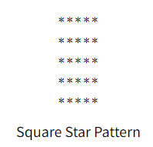
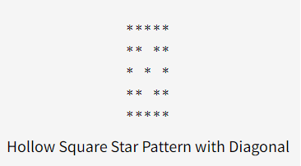
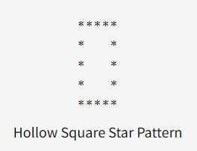
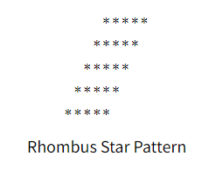
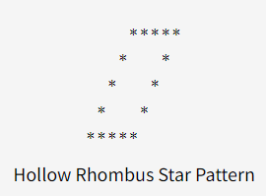
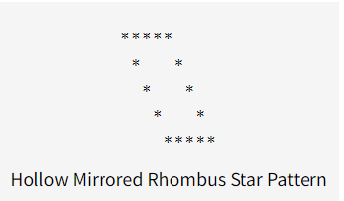
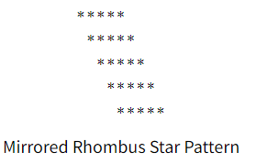
Task 52
Star pattern programs – write a program to print the given star patterns.

Slide 110
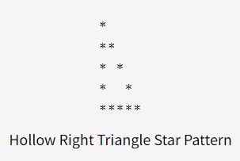
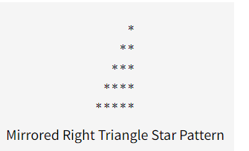
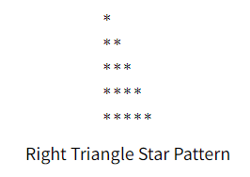
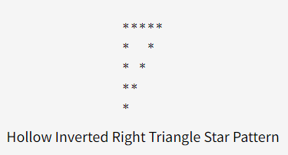
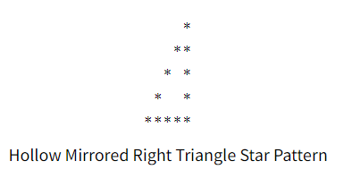
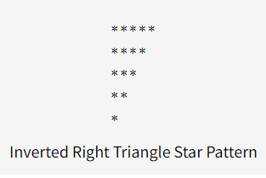
Continuous

Slide 111
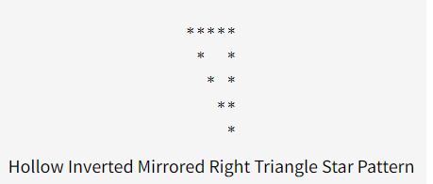
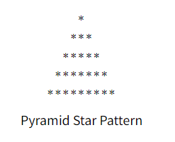
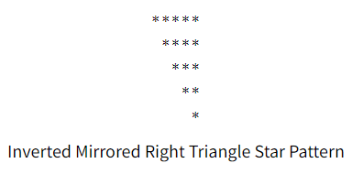
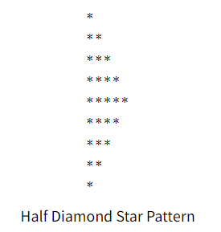
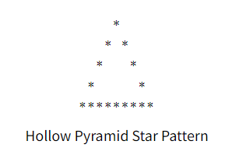
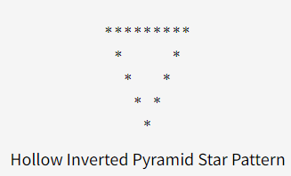
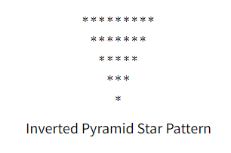
Continuous

Slide 112
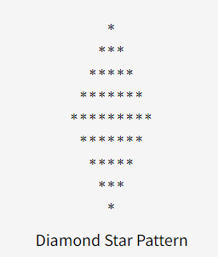
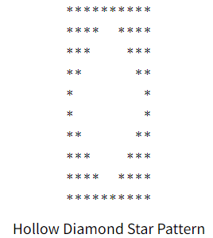
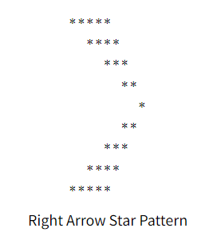
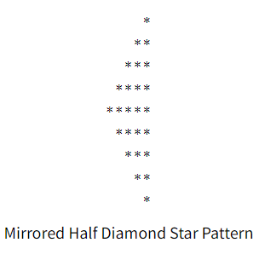
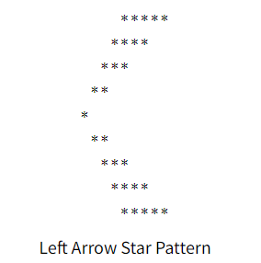
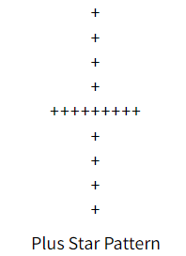
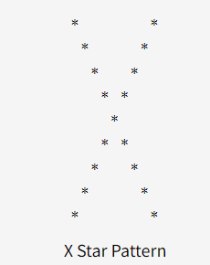
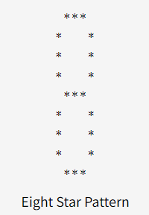
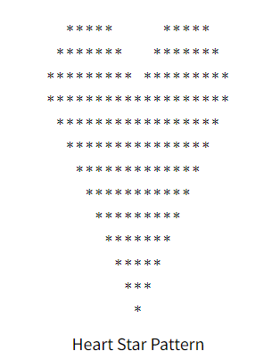
Start programming

Slide 113
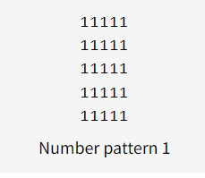
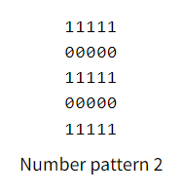
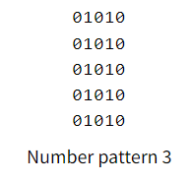
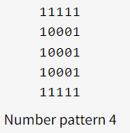
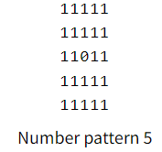
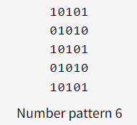
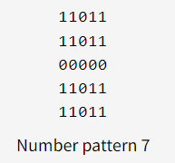
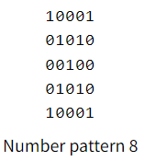
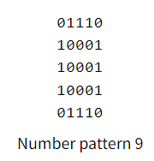
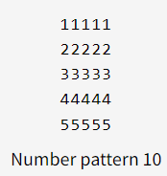
Task 53
Number pattern programs – write a program to print the given number pattern.

Slide 114
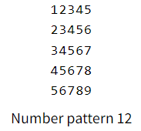
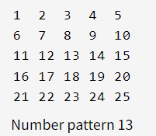
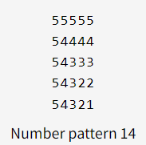
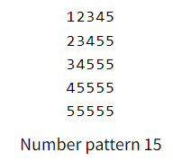
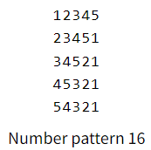
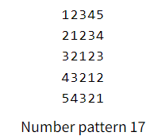
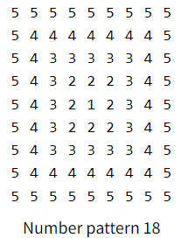
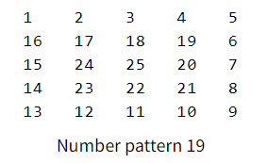
Number pattern

Slide 115
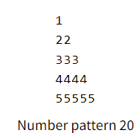
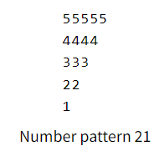










Triangle

Slide 116




Triangle 0,1 easy number patterns

Slide 117










Triangle hard Number Pattern

Slide 118






Continuous

Slide 119




Diamond Number Patterns

Slide 120

Tricky Number Patterns

Slide 121
Function and Recursion Exercise

Slide 122
Task 1
Write a program to find cube of any number using function

Slide 123
Task 2
Write a program to find diameter, circumference and area of circle using functions

Slide 124
Task 3
Write a program to find maximum and minimum between two numbers using functions

Slide 125
Task 4
Write a program to check whether a number is even or odd using function.

Slide 126
Task 5
Write a program to check whether given number is prime, Armstrong or prefect number using function

Slide 127
Task 6
Write a program to find all prime number between given interval using function.

Slide 128
Task 7
Write a program to print all strong numbers between given interval using function.

Slide 129
Task 8
Write a program to print all Armstrong numbers between given interval using function.

Slide 130
Task 9
Write a program to print all perfect numbers between given interval using functions

Slide 131
Task 10
Write a program to find power of any number using recursion.

Slide 132
Task 11
Write a program to print all natural number between 1 to n using recursion.

Slide 133
Task 12
Write a program to print all even or all odd numbers in given range using recursion.

Slide 134
Task 13
Write a program to find sum of all natural numbers between 1 to n using recursion.

Slide 135
Task 14
Write a program to find sum of all even or odd numbers in given range using recursion.

Slide 136
Task 15
Write a program to find reverse of any number using recursion.

Slide 137
Task 16
Write a program to check whether a number is palindrome or not using recursion.

Slide 138
Task 17
Write a program to find sum of digits of a given number using recursion.

Slide 139
Task 18
Write a program to find factorial of any number using recursion.

Slide 140
Task 19
Write a program to generate nth Fibonacci term using recursion.

Slide 141
Task 20
Write a program to find GCD(HCF) of two number using recursion.

Slide 142
Task 21
Write a program to find LCM of two number using recursion.

Slide 143
Task 22
Write a program to display all array elements using recursion.

Slide 144
Task 23
Write a program to find sum of elements of array using recursion

Slide 145
Task 24
Write a program to find maximum and minimum element in array using recursion.

Slide 146
Array Programming Exercise

Slide 147
Task 1
Write a program to read and print element of an array using recursion

Slide 148
Task 2
Write a program to print all negative elements in an array

Slide 149
Task 3
Write a program to find sum of all elements in an array

Slide 150
Task 4
Write a program to find maximum and minimum element in an array using recursion

Slide 151
Task 5
Write a program to find second largest element in an array

Slide 152
Task 6
Write a program to count total number of even and odd elements in an array

Slide 153
Task 7
Write a program to count total number of negative element in an array

Slide 154
Task 8
Write a program to copy all elements from an array to another array

Slide 155
Task 9
Write a program to insert an element in an array.

Slide 156
Task 10
Write a program delete an element from an array at specific position

Slide 157
Task 11
Write a program to count frequency of each element in array

Slide 158
Task 12
Write a program to print all unique elements in the array

Slide 159
Task 13
Write a program to count total number of duplicate elements in an array

Slide 160
Task 14
Write a program to delete all duplicate elements from an array

Slide 161
Task 15
Write a program to merge two array to third array

Slide 162
Task 16
Write a program to find reverse of an array

Slide 163
Task 17
Write a program to put even and odd elements of array in two separate array

Slide 164
Task 18
Write a program to search an element in an array

Slide 165
Task 19
Write a program to sort array elements in ascending order or descending order.

Slide 166
Task 20
Write a program to sort even and odd elements of array separately.

Slide 167
Task 21
Write a program to left rotate an array

Slide 168
Task 22
Write a program to right rotate an array

Slide 169
Matrix Programming exercise

Slide 170
Task 1
Write a program to add two matrices

Slide 171
Task 2
Write a program to subtract two matrices

Slide 172
Task 3
Write a program to perform scalar matrix multiplication

Slide 173
Task 3
Write a program to multiply two matrices

Slide 174
Task 4
Wrote a program to check whether two matrices are equal or not.

Slide 181
String Programming Exercise

Slide 182
Task 1
Write a program to find length of a string

Slide 183
Task 2
Write a program to copy one string to another string

Slide 184
Task 3
Write a program to concatenate two strings

Slide 185
Task 4
Write a program to compare two string

Slide 186
Task 5
Write a program to convert lowercase string to uppercase string

Slide 187
Task 6
Write a program to convert uppercase string to lowercase string.

Slide 188
Task 7
Write a program to toggle case of each character of a string.

Slide 189
Task 8
Write a program to find total number of alphabets, digits or special character in a string.

Slide 190
Task 9
Write a program t count total number of vowels and consonants in a string

Slide 191
Task 10
Write a program to count total number of words in a string

Slide 192
Task 11
Write a program to find reverse of a string.

Slide 193
Task 12
Write a program to check whether a string is palindrome or not.

Slide 194
Task 13
Write a program to reverse order of words in a given string.

Slide 195
Task 14
Write a program to find first occurrence of a character in a given string.

Slide 196
Task 15
Write a program to find last occurrence of a character in given string.

Slide 197
Task 16
Write a program to search all occurrences of a character in given string.

Slide 198
Task 17
Write a program to count occurrence of a character in given string.

Slide 199
Task 18
Erite a program to find highest frequency character in a string.

Slide 200
Task 19
Write a program to find lowest frequency character in a string.

Slide 201
Task 20
Write a program to count frequency of each character in a string.

Slide 202
Task 21
Write a program to remove first occurrence of a character from string.

Slide 203
Task 22
Write a program to remove last occurrence of a character from string.

Slide 204
Task 23
Write a program to remove all occurrence of a character from string.

Slide 205
Task 24
Write a program to remove all repeated character from a given string.

Slide 206
Task 25
Write a program to replace first occurrence of a character with another in a string.

Slide 207
Task 26
Write a program to replace last occurrence of a character with another in string.

Slide 208
Task 27
Write a program to replace all occurrence of a character with another in a string.

Slide 209
Task 28
Write a program to find first occurrence of a word in a given string.

Slide 210
Task 29
Write a program to find last occurrence of a word in a given string.

Slide 211
Task 30
Write a program to search all occurrence of a word in given string.

Slide 212
Task 31
Write a program to count occurrences of a word in a given string.

Slide 213
Task 32
Write a program to remove firet occurrence of a word from string.

Slide 214
Task 33
Write a program to remove last occurrence of a word in given string.

Slide 215
Task 34
Write a program to remove all occurrence of a word in given string.

Slide 216
Task 35
Write a program to trim leading white space characters from given string.

Slide 217
Task 36
Write a program to trim both leading and trailing white space characters from given string.

Slide 218
Task 37
Write a program to trim leading and trailing white space characters from given string.

Slide 219
Task 38
Write a program to remove all extra blank spaces from given string.

